Slide 1
Practicing sequence alignment
MED676 Bioinformatics Module
Dr. Dennis Wang
Notes:
Welcome to the pre-lecture of the MED676 Bioinformatics Module part of the Genomic Medicine programme at the university of Sheffield
Today I will briefly give an introduction to the sequence alignment of genomes

Slide 2
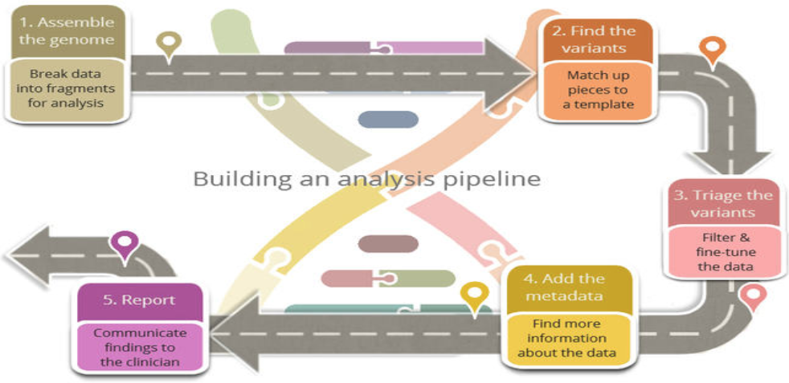
Bioinformatics pipeline / workflow

Slide 3
Galaxy access
https://bioinf-galaxian.erasmusmc.nl/galaxy/
Surnames: A-K
http://galaxy.dbcls.jp/
Surnames: L-N
http://services.cbib.u-bordeaux.fr/galaxy/
Surnames: O-Z

Slide 4
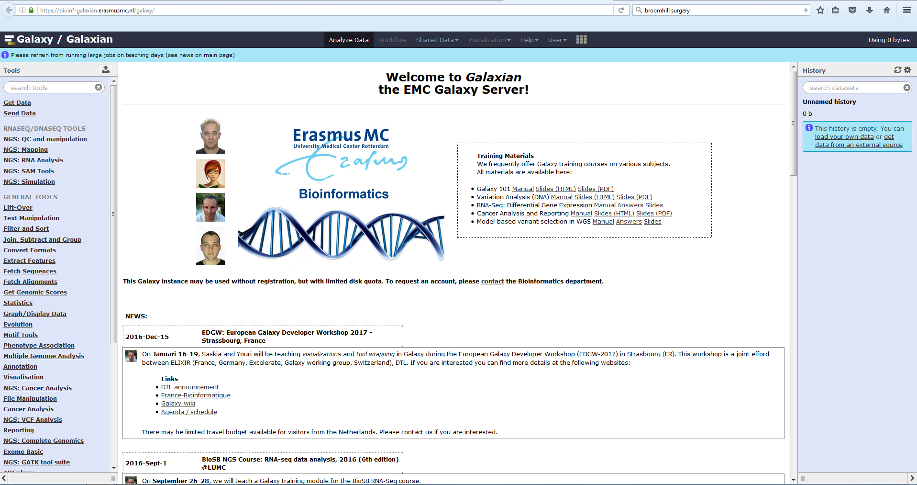

Slide 5
Exercise
Find an interesting NGS sequence data set
Notes:
In clinical applications of NGS, the bioinformatics workflow starts from getting the raw sequence data to generating the report to communicate findings to the clinician. Please note that the pipeline rarely linear and there is often feedback to tune the parameters for any given stage of data processing.

Slide 6
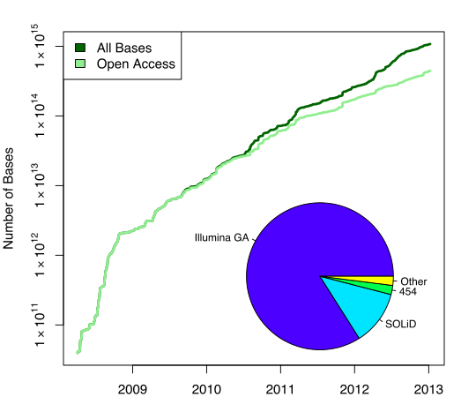
Explore European Nucleotide Archive (EBI ENA/SRA)
Repository providing free and unrestricted access to DNA and RNA sequence data
From Human, mouse, plants, etc.
All types of samples: tissues, cell-lines, FFPE

Slide 7
Targeted sequencing
DNA is captured from specific regions of the genome and then sequenced
Captured regions should be relevant to disease (eg. Exons with BRAF V600E or EGFR L858R)
also known as a panel
These regions are sequenced very deeply to ensure accuracy of the variant identification

Slide 8
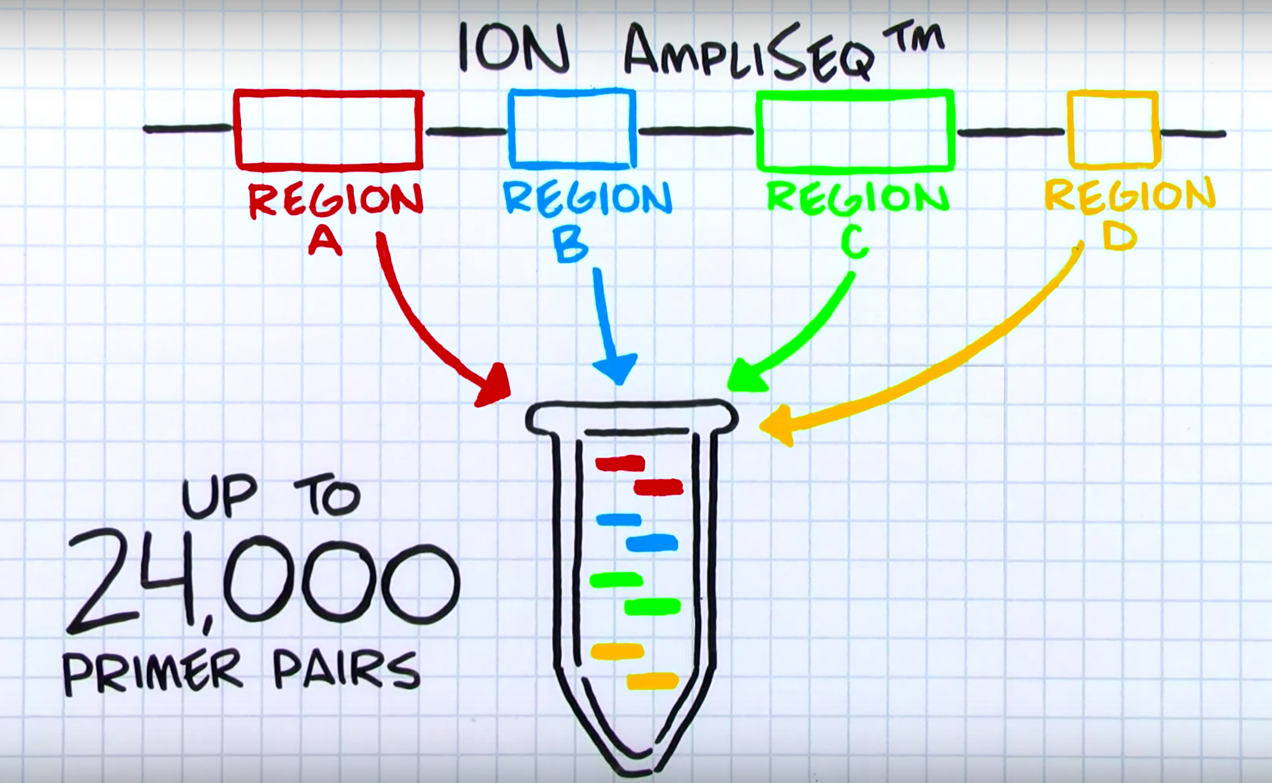

Slide 9
Exercise
Retrieve an “EGFR amplicon lung cancer” sequencing panel
What sequencing instrument was used?
Was this data set published?
Where did the samples come from?
Notes:
In clinical applications of NGS, the bioinformatics workflow starts from getting the raw sequence data to generating the report to communicate findings to the clinician. Please note that the pipeline rarely linear and there is often feedback to tune the parameters for any given stage of data processing.

Slide 10
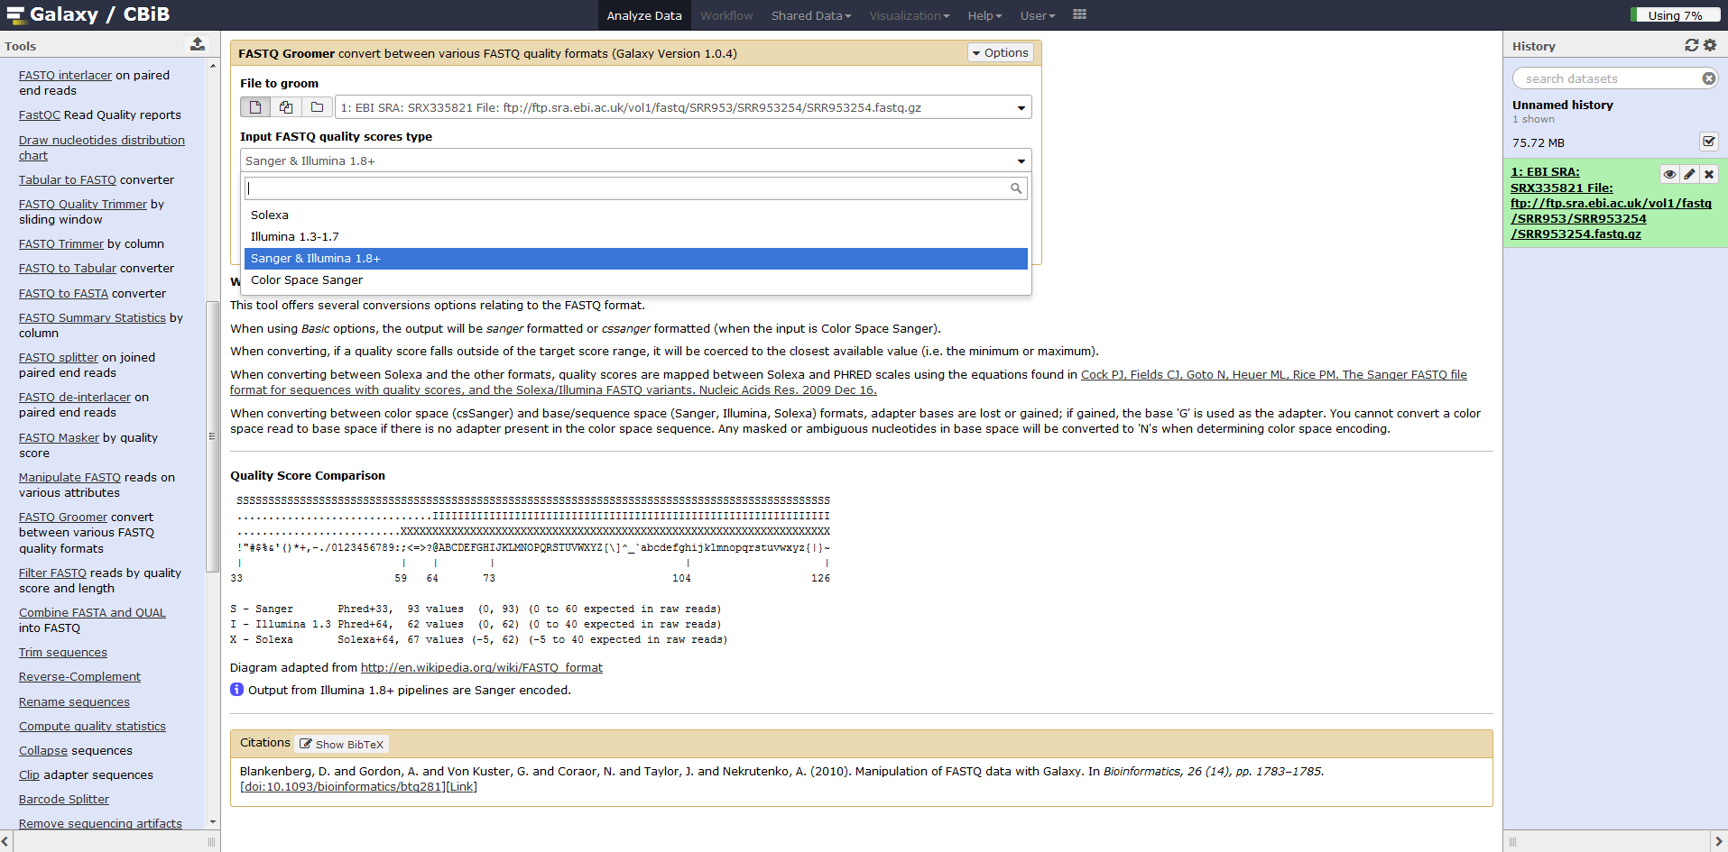

Slide 11
Exercise
What is the file format of the fastq?
Align the sequence using the Bowtie aligner
Try it several times with different settings (eg. fast vs sensitive)
Notes:
In clinical applications of NGS, the bioinformatics workflow starts from getting the raw sequence data to generating the report to communicate findings to the clinician. Please note that the pipeline rarely linear and there is often feedback to tune the parameters for any given stage of data processing.

Slide 12
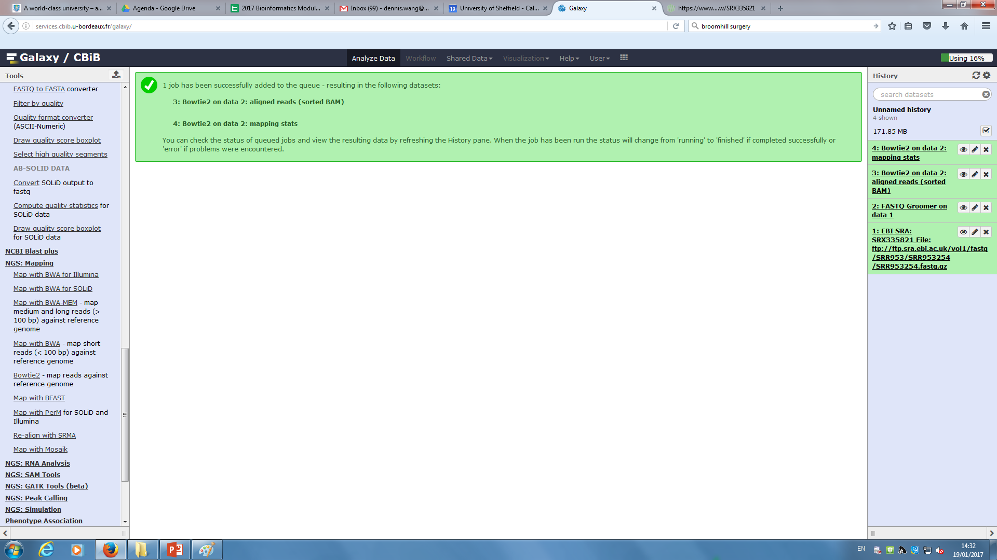

Slide 13
Congratulations!
You have extracted, processed, and assembled your first genomic sequences!
Notes:
In clinical applications of NGS, the bioinformatics workflow starts from getting the raw sequence data to generating the report to communicate findings to the clinician. Please note that the pipeline rarely linear and there is often feedback to tune the parameters for any given stage of data processing.

Slide 14
Exercise
Visualize the aligned reads in IGV
Find a mutation
Any differences between alignments using different settings?
Notes:
In clinical applications of NGS, the bioinformatics workflow starts from getting the raw sequence data to generating the report to communicate findings to the clinician. Please note that the pipeline rarely linear and there is often feedback to tune the parameters for any given stage of data processing.

Slide 15
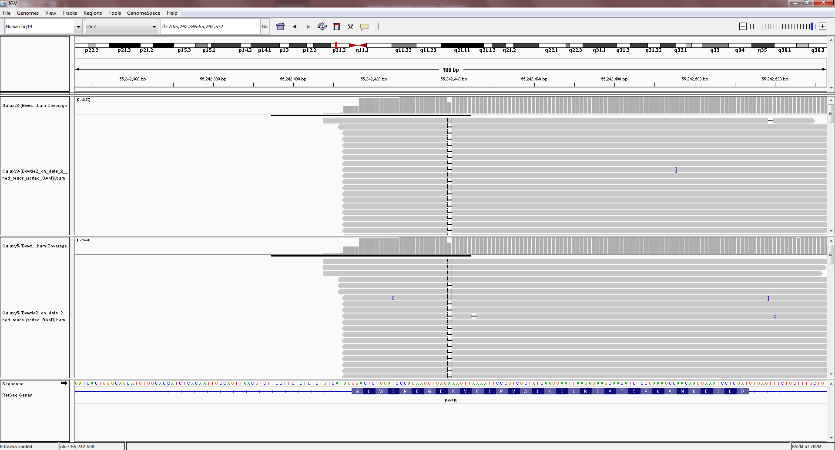
EGFR exon 19 deletion?

Slide 16
End of Day 1
Any questions?
Please complete the feedback:
https://goo.gl/forms/938nR2f00sXWJaks2

